Slide 1
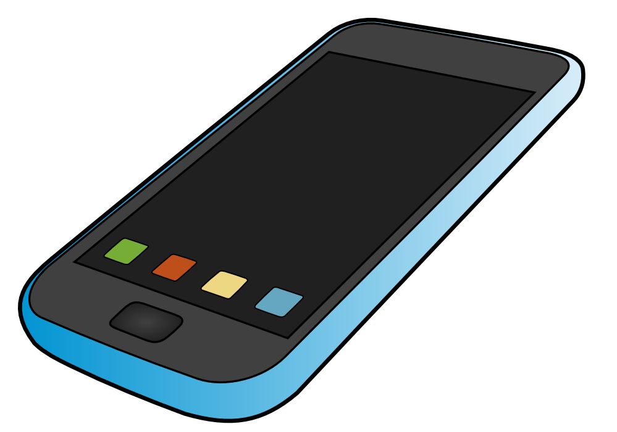

Mobile Banking
Instructions
Convenient. Secure. Anytime.

Slide 2
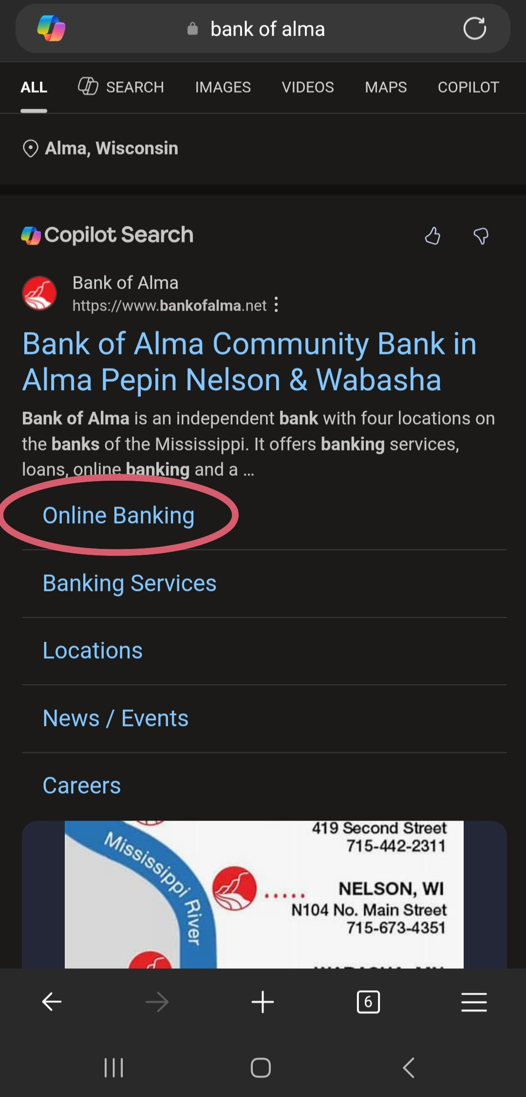
Searching for Bank of Alma Website
Go to your internet browser:
  Google
  Safari
  Microsoft Edge
  Etc.
Search:
  Bank of Alma, WI or www.bankofalma.net
Click on:
  Online Banking

Slide 3
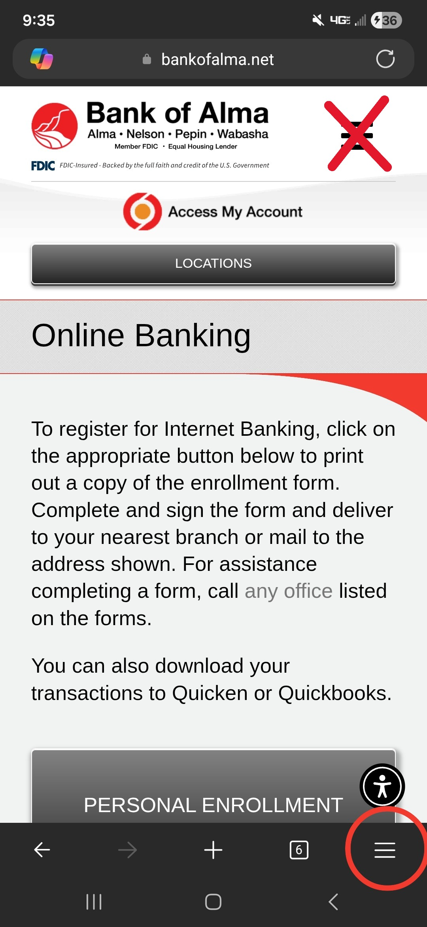
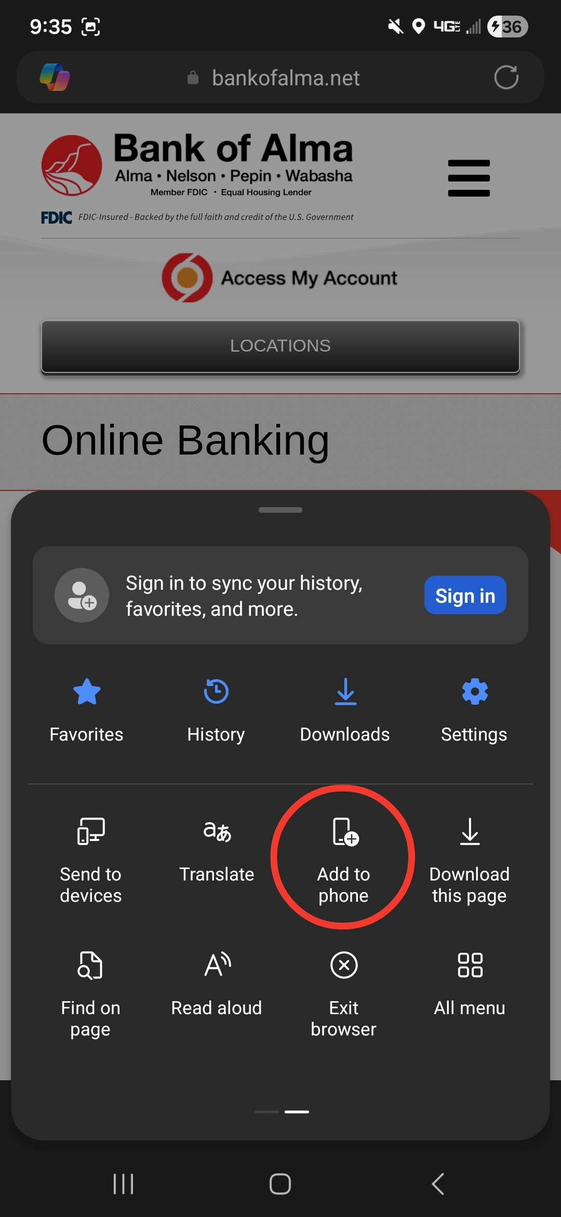
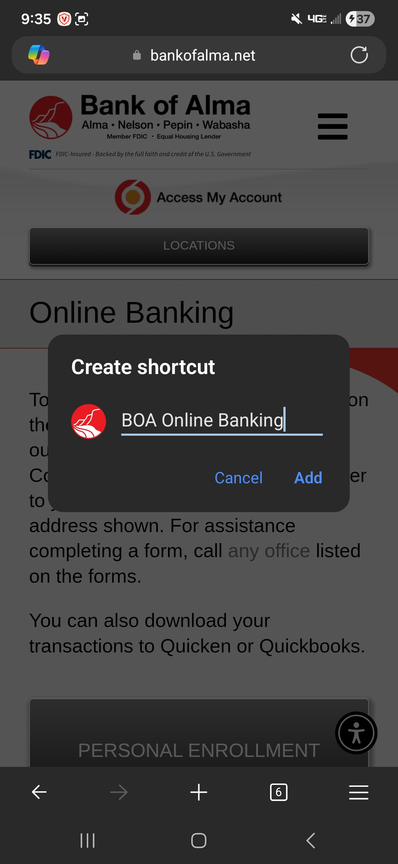
How to save the site to any smartphone or tablet home page
Click on your internet explorer menu button.
Look for an “Add to phone” option.
Choose a nickname for the icon.
  Bank of Alma
  Online Banking
  Etc.

Slide 4
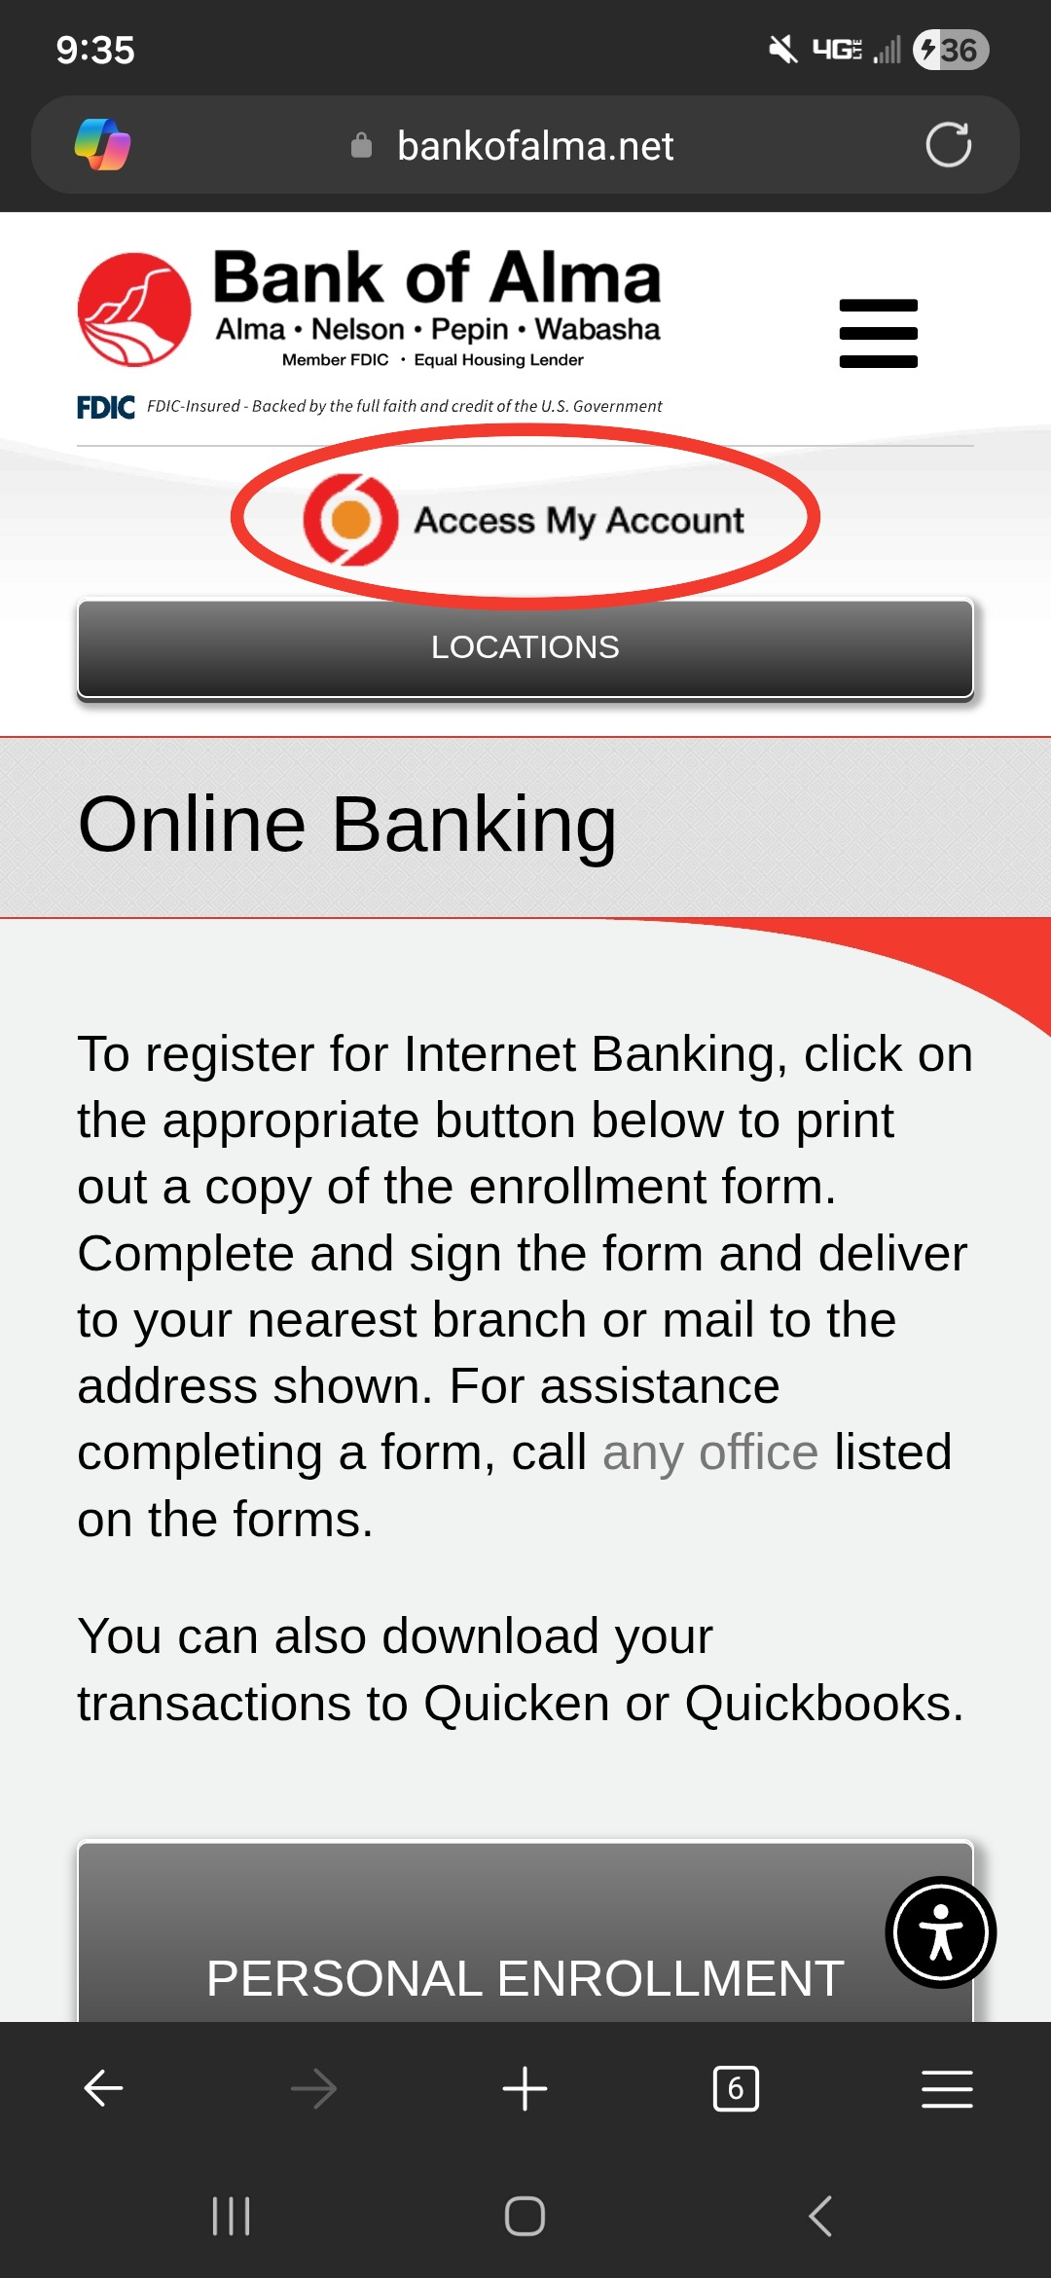
Access Account
Located at the top of the webpage is an ‘Access My Account’ button; click this button.
  Depending on what device and search engine you are using, you may have to double click.

Slide 5
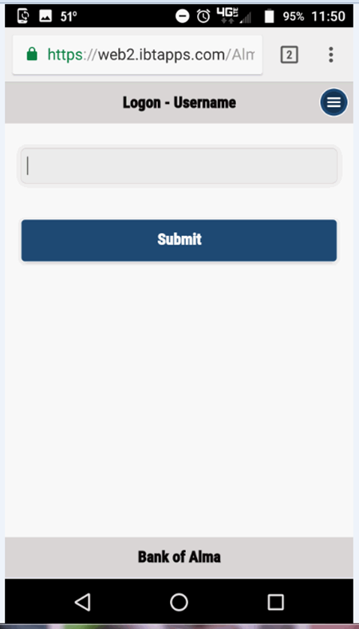
Login Using Your Information
Enter and submit your username.
Answer your security question, if prompted.
Enter and submit password.
Your phone should automatically display the online banking as a “mobile site”, as shown to the left.
  If using a phone and the screen does not look like the example to the left, follow the directions on the next slide.

Slide 6
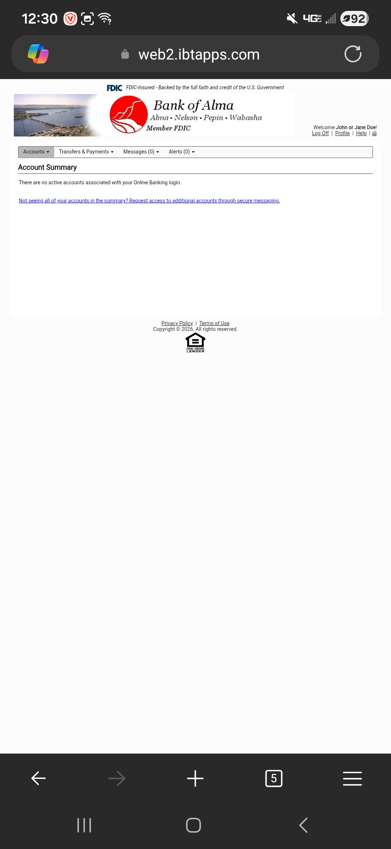
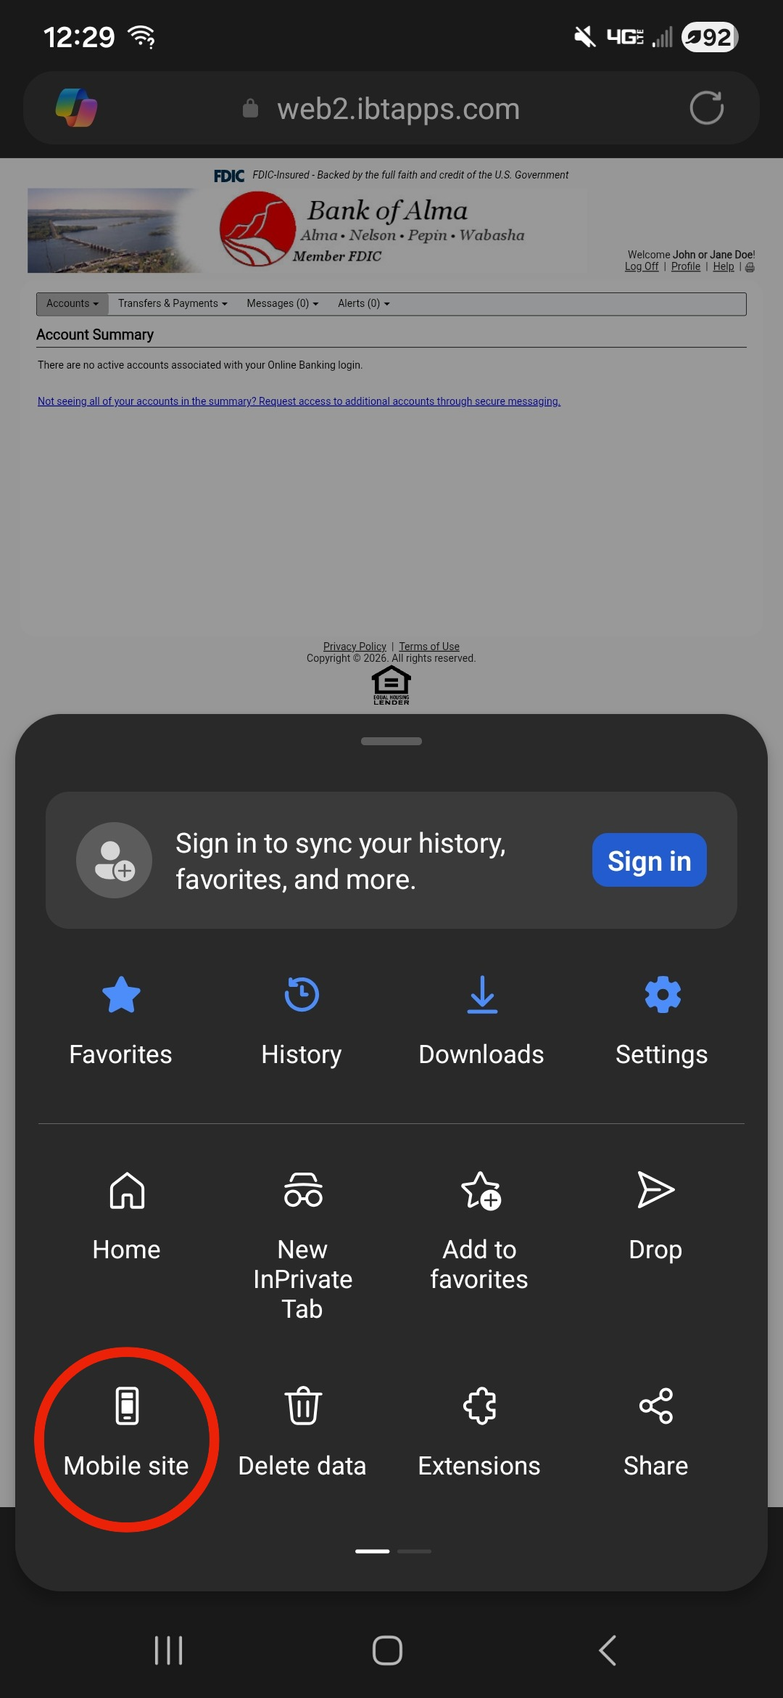
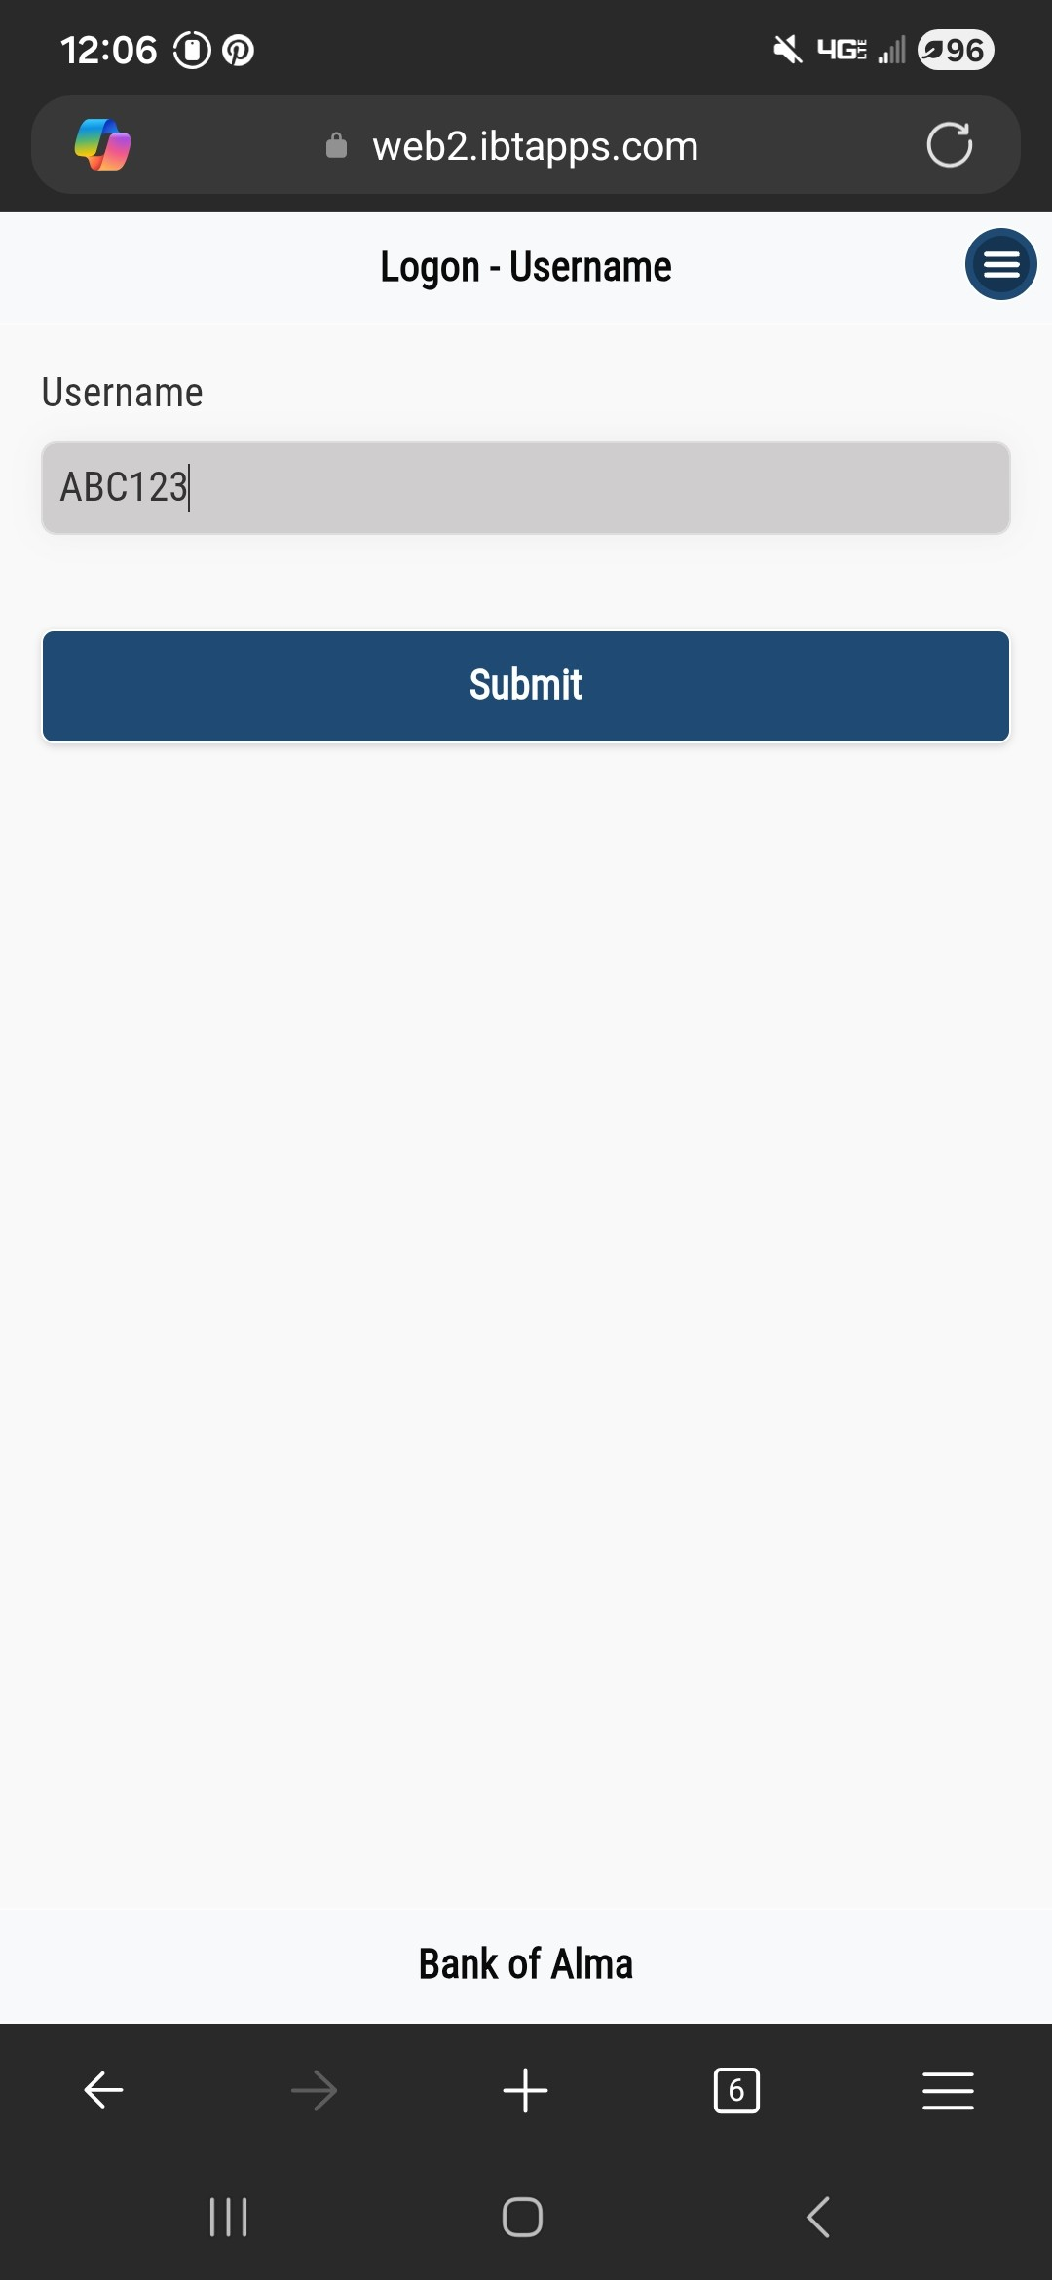
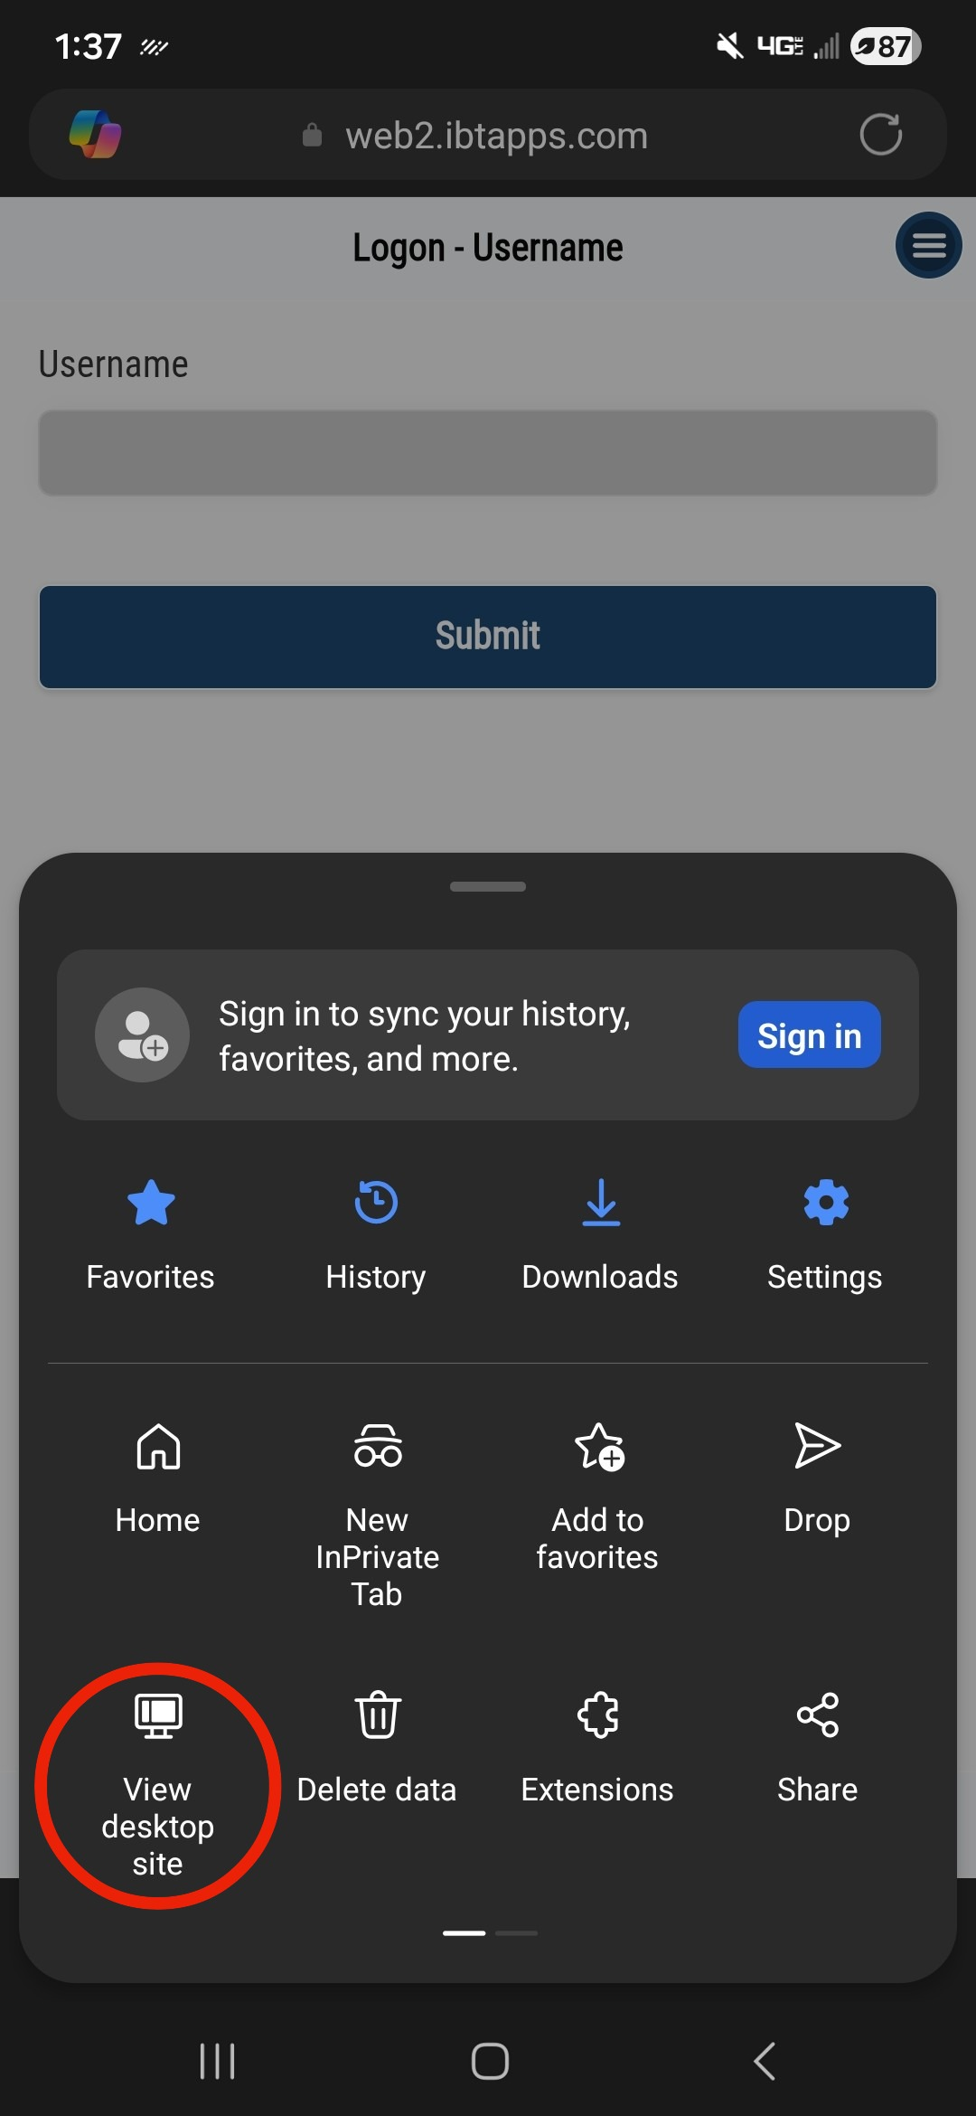
Switching Between Desktop and Mobile Displays
You may switch between the desktop display and the mobile banking display as shown here.
Desktop Display
Switch to Mobile Site
Mobile Display
Switch to Desktop Site

Slide 7
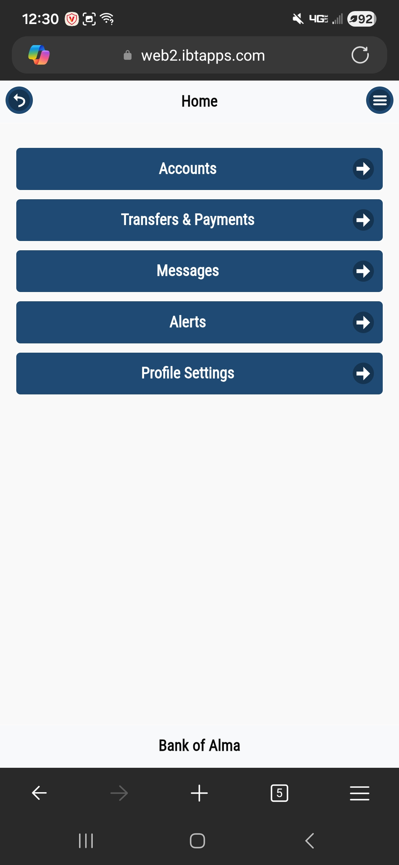
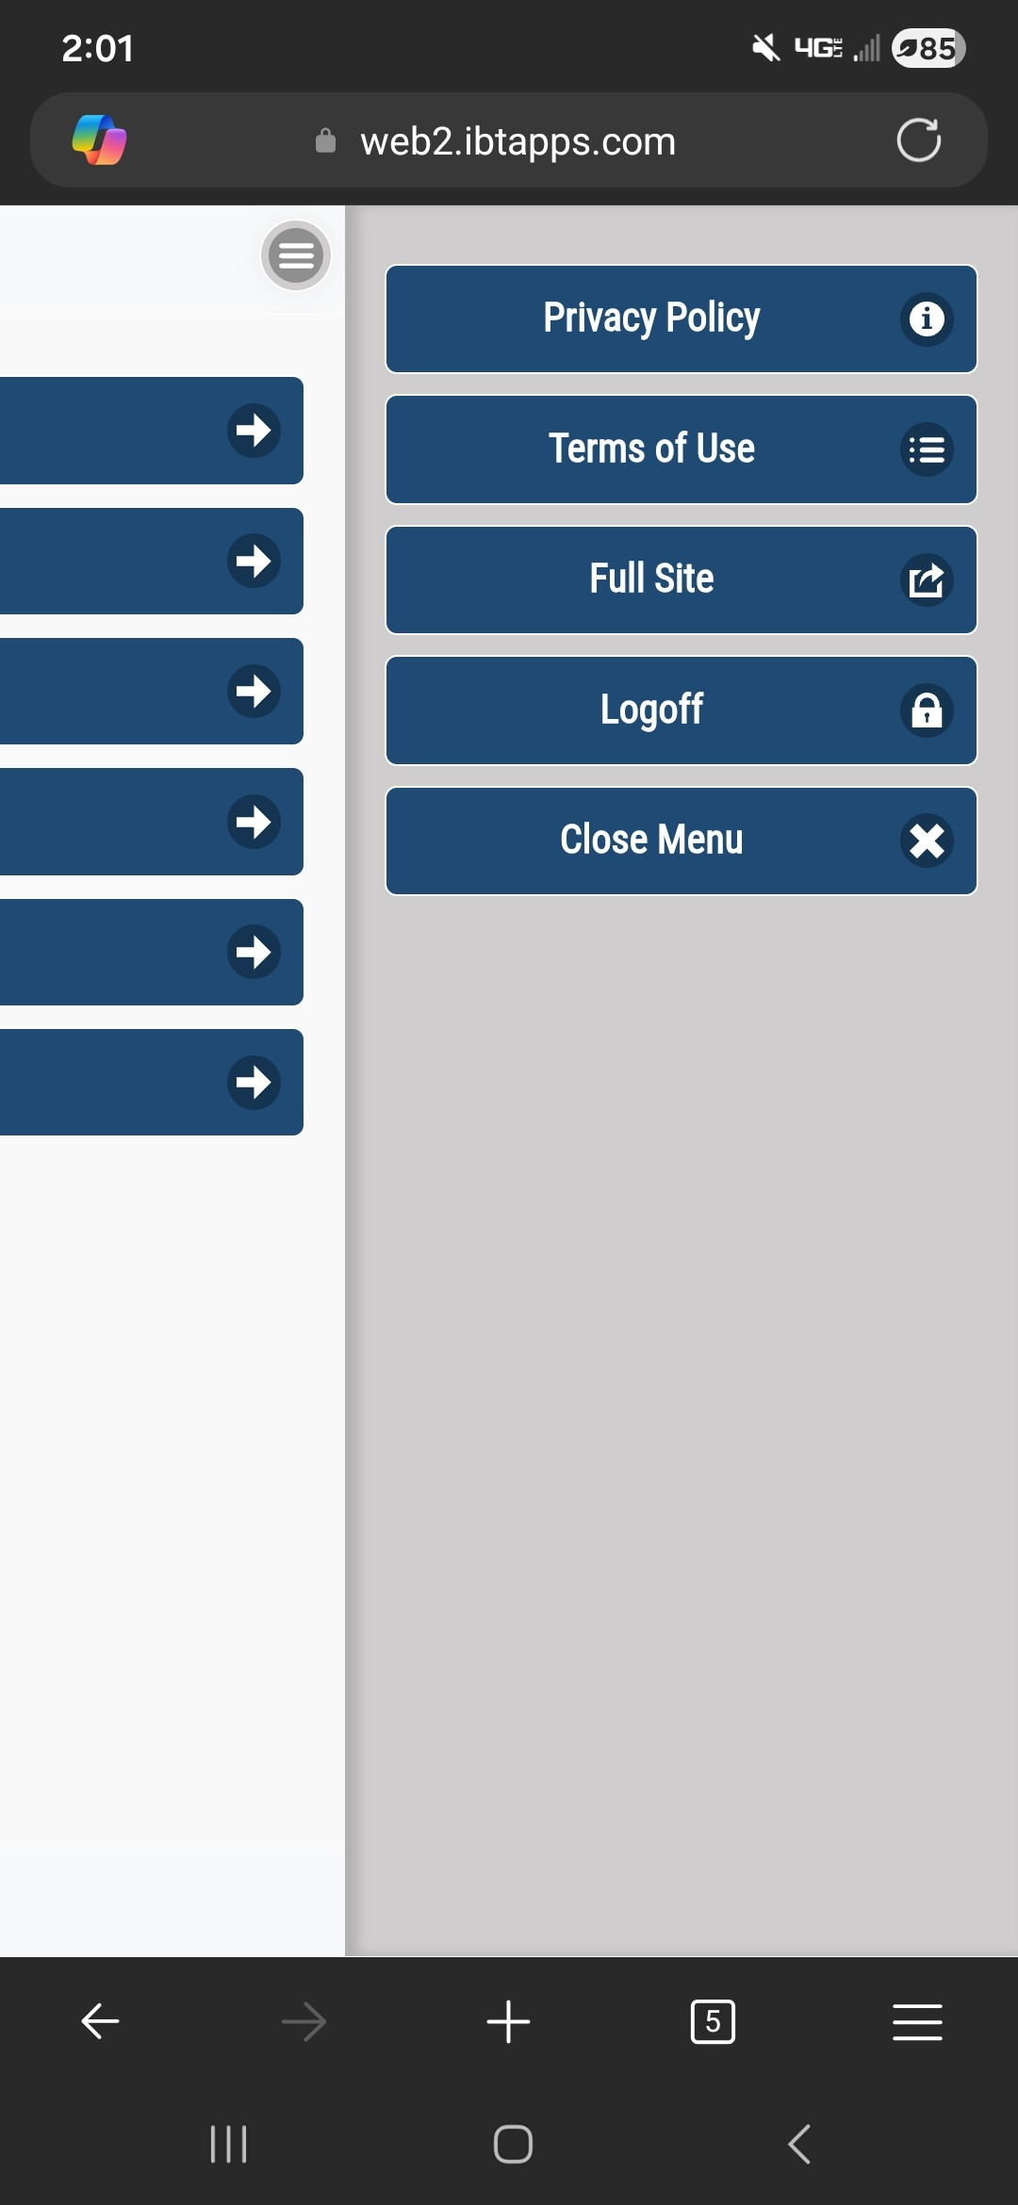
Mobile Banking Home Page
From here you have the options to:
Accounts
View all your active and inactive account(s).
View your transactions.
Transfers & Payments
Transfer money between accounts; as well as set up automatic, recurring transfers.
Make payments to any loans.
Messages
Send secure messages direct to the Bank of Alma staff.
Alerts*
Alerts can be set up to notify you via email or text of any account changes or for security related events. Some examples are:
Profile Settings*
Change any profile setting and/or preferences.
*See next slide(s) for more information.

Slide 8
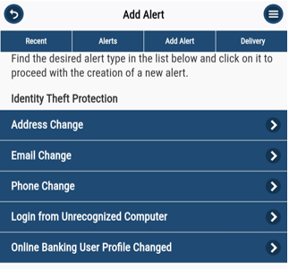
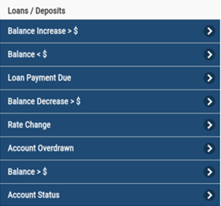
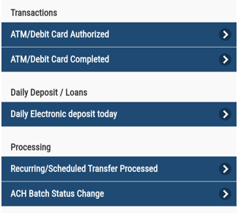
Alerts

Slide 9
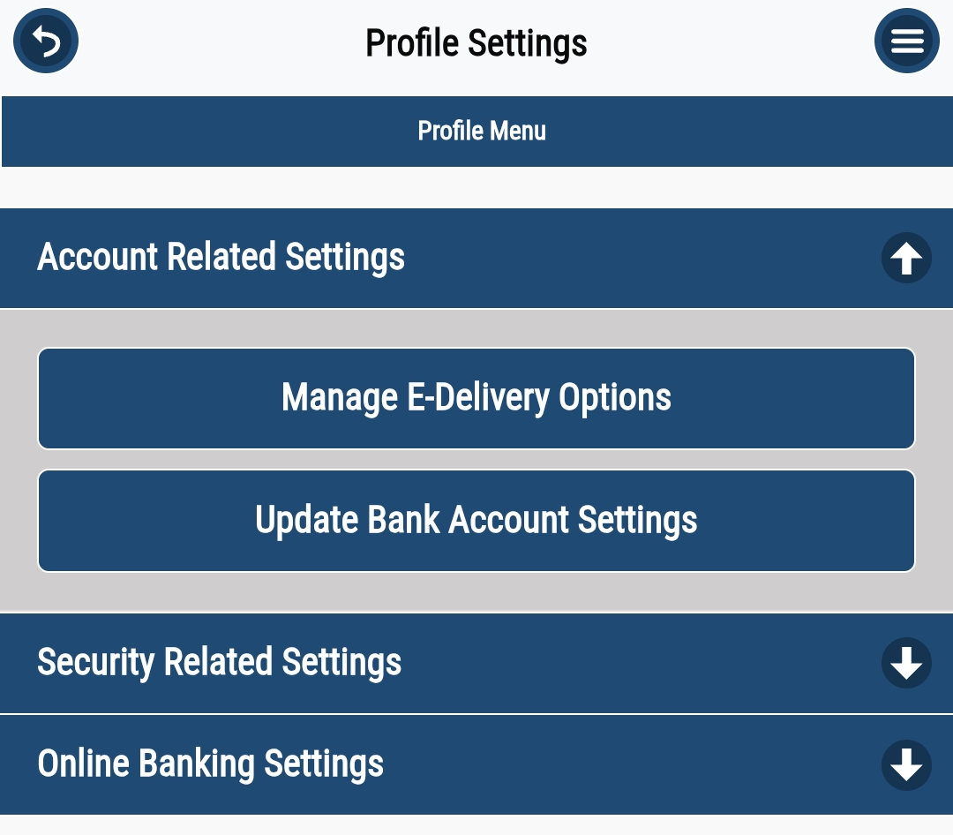
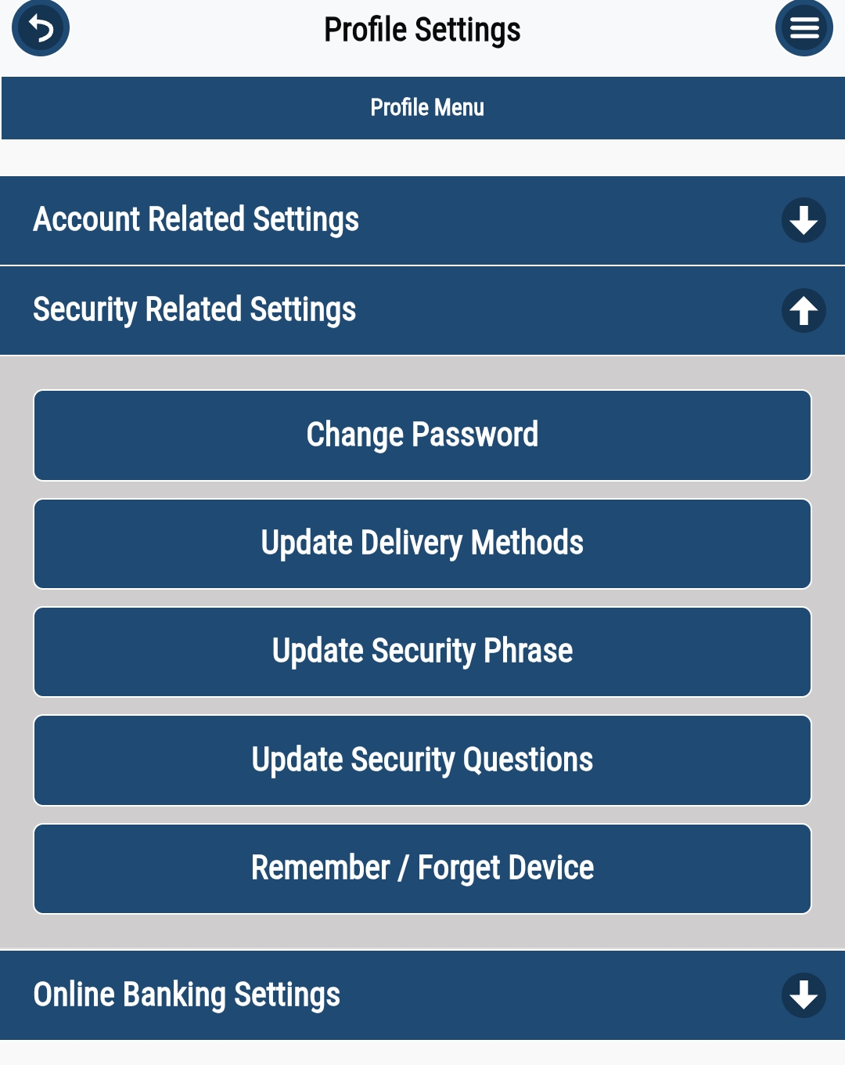
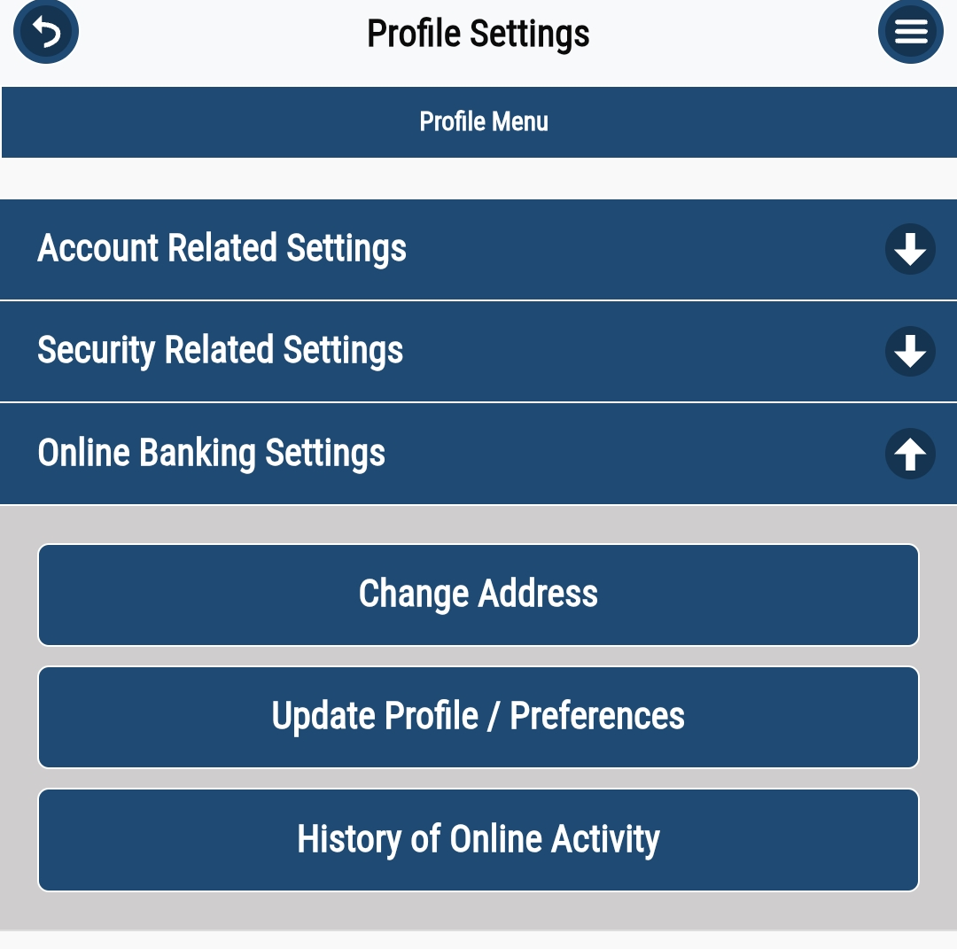
Profile Settings

Slide 10
Thank you for banking with the Bank of Alma.
Friends Serving Friends

